Slide 1
Statistical Analysis 1
Prof Vishnuprasad Nagadevara
Nagadevara_v@isb.edu

Slide 2
My Journey
GB Pant University of Agrl and Technology
Agricultural College Bapatla
1970
1968
Iowa State University
1974
IIM Bangalore
1976-2014

Slide 3
Session No. |  | Topics | Readings
1 | Review of Probability Concepts and Bayes’ Theorem, discrete and continuous distributions Case: Agony of Attrition Case: How much to pack? |  | Ch 2, 3 and 4
2 | Sampling Variation, Central Limit Theorem Exercise on Sampling Confidence Intervals (I): Population Mean (σ known) Case: Is Medworld Cheating? |  | Ch. 5 Ch. 6.1-6.2
3 | Determining sample size Case: Is Medworld Cheating? Confidence Intervals (II): Population mean (σ not known) Determining sample size Case: Is Medworld Cheating? Confidence intervals for population proportion Determining minimum sample size required Case: Is Medworld cheating? |  | Ch. 6.3-6.6
4 | Hypothesis Testing; introduction to Type I and Type II errors Conducting two-sided hypothesis test for mean Calculation and interpretation of p-value Case: How much to pack |  | Ch. 7.1`-7.2
5 | Hypothesis test for mean (σ not known) Conducting two-sided hypothesis test for proportion One-sided hypothesis test Case: Bending of Belmadi Determining sample size Case: Breaking Windshields |  | Ch. 7.2-7.5

Slide 4
Grading Scheme
Assignment 50%
Final 50%

Slide 5
PROBABILITY
TYPES OF PROBABILITY
CLASSICAL PROBABILITY:
NUMBER OF OUTCOMES WHERE THE EVENT OCCURS/TOTAL NUMBER OF POSSIBLE OUTCOMES
(ASSUMPTION:EACH POSSIBLE OUTCOME IS EQUALLY LIKELY)
RELATIVE FREQUENCY
SUBJECTIVE PROBABILITY
THE VALUES LIE IN THE INTERVAL (0,1)

Slide 6
Probability
Marginal Probability
P(E)
Joint Probability
P(E and S)
Conditional Probability
P(E|S)

Slide 7
Finance Companies Data
Size
Operating Income (Rs. Mill) |  | Frequency | Relative Frequency
< 1 | Tiny | 15 | 0.15
1 - 5 | Small | 20 | 0.20
5 - 10 | Medium | 14 | 0.14
10 - 50 | Big | 25 | 0.25
≥ 50 | Hyper | 26 | 0.26
Total |  | 100 | 1.00
Performance
Operating Profit (Rs. Mill) |  | Frequency | Relative Frequency
< 0 | Poor | 14 | 0.14
0 - 2.5 | Low | 26 | 0.26
2.5 - 15 | Good | 32 | 0.32
15 - 100 | Excellent | 18 | 0.18
≥ 100 | Outstanding | 10 | 0.10
Total |  | 100 | 1.00
Launch Poll 1

Slide 8
Finance Companies Data

Slide 9
Review the Following
Collectively exhaustive events
Mutually exclusive events
Statistical independence
Bayes Theorem

Slide 10
Agony of Attrition

Slide 11
Dinesh
Lakshmi
Partho
S
S₁S₂S₃
0.512
0.8
S
L
S₁S₂L₃
0.128
0.8
0.2
S
S₁L₂S₃
0.128
S
L
0.8
0.8
0.2
L
0.2
S₁L₂L₃
0.032
L
S
L₁S₂S₃
0.128
0.8
0.2
L
S
0.8
0.2
L₁S₂L₃
0.032
L
L₁L₂S₃
0.032
S
0.2
0.8
L
0.2
L₁L₂L₃
0.008

Slide 12
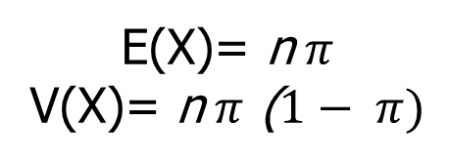
Probability Mass Function
X = No. Leaving | Probability | Calculation | Formula
0 | 0.512 | (1) (0.8)(0.8)(0.8) | (³C₀)(0.8)³(0.2)⁰
1 | 0.384 | (3) (0.8)(0.8)(0.2) | (³C₁)(0.8)²(0.2)¹
2 | 0.096 | (3) (0.8)(0.2)(0.2) | (³C₂)(0.8)¹(0.2)²
3 | 0.008 | (1)(0.2)(0.2)(0.2) | (³C₃)(0.8)⁰(0.2)³
Total | 1.000
$$P\left(X\right)={}_{ }^{n}{C_{X}π^{X}{(1−π)}^{n−X}, X=0,1,…,n}$$
E(X)= n$π$
V(X)= n$π$ ($1− π)$
USE EXCEL

Slide 13
Normal Distribution
Normal Distribution

Slide 14
Normal Distribution “Model”
µ=150
σ=50
The graph of the pdf (probability density function) is a bell shaped curve
The normal random variable takes values from - ∞ to +∞
It is symmetric and centered around the mean (which is also the median and mode)
Any normal distribution can be specified with just two parameters – the mean (µ) and the standard deviation (σ)
We write this as X~N(µ,σ²)
Notes:
Let’s move to a continuous distribution now. Let me start by claiming that if you had time to study only one continuous distribution, it would have to be Normal. Why?
Beautiful and elegant mathematics
Found in many business contexts
Answer is a combination of both. It has nice and elegant math but so do some others and this turns out to be useful. But also, many RVs of business interest can be modeled as normal distribution.
The picture that you see here is called the probability density function of the normal distribution or pdf. So first it is a continuous distribution. You need only two things to completely specify a distribution – mean and variance. You cannot have two distributions with the same mean and variance. It is symmetric around the mean, which is also its median and mode.
Now think what happens to the distribution if you increase the mean – it shifts rightward. What happens if I increase the standard deviation but not the mean – it will squish.

Slide 15
Probability Calculations for the Normal “Model”
The probability associated with any single value of the random variable is not defined
Probability of values being in a range = Area under the pdf curve in that range
Area under the entire curve = P(- ∞ ≤ X ≤ + ∞) = 1
Two methods to calculate P(X ≤ x)
Use MS Excel®: NORMDIST(x, μ, σ, 1)
Use Z-scores and Standard Normal Distribution
P(x₁ ≤ X ≤ x₂) = P(X≤ x₂) - P(X≤ x₁)

Slide 16
Use Excel Sheet

Slide 17
Evaluation of the Normal “Model”
How can we say that the normal distribution is a reasonable approximation of the data?
How can data look different from a normal distribution?
Single mode: More than one mode suggesting data come from distinct groups
Symmetric: Lack of symmetry
Unusual extreme values
We can identify these differences by looking at
Visual inspection of the histogram (not very accurate)
Numerical summaries like Skewness and Kurtosis
Graphical summaries (Normal Quantile plot)
Empirical Rule
P(µ - σ ≤ X ≤ µ + σ ) = P(-1 ≤ Z ≤ +1) = 0.6827
P(µ - 2σ ≤ X ≤ µ + 2σ ) = P(-2 ≤ Z ≤ +2) = 0.0.9545
P(µ - 3σ ≤ X ≤ µ + 3σ ) = P(-3 ≤ Z ≤ +3) = 0.9974
Launch Poll 2
Notes:
Now going forward, we are going to make extensive use of normal distribution in our calculation. So as a caution it is also important to check if the data is approximately normal or not. You can obviously have skewed distributions – median is less than or more than the mean. You can have more than one mode, which might denote a mixture distribution.
In terms of actually quantifying it, you can look at skewness and kurtosis. These are zero for normal distribution and farther the numbers are from zero, less likely is the distribution to be normal.
There is another graphical way rather than just inspecting the histogram

Slide 18
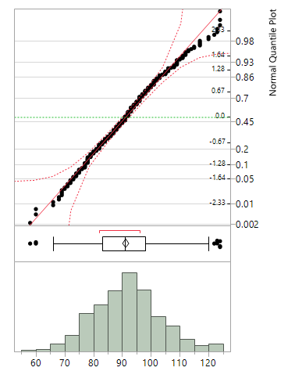
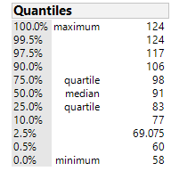
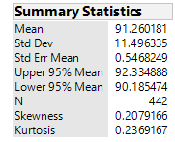
Can we model the glucose by a normal distribution with μ = 91 and σ = 11.5?

Slide 19

Case - How Much to pack?
Vishnuprasad Nagadevara

Slide 20
What we know
The weight of cereal follows normal distribution
Akash has set the machine to fill at an average level of 1005 gms. (5 gms higher than 1000 gms)
Akash is proud that not a single packet was under weight
We also know that P(µ – 3σ ≤ X ≤ µ + 3σ) = 0.9974 ≈ 1.00
FDA requirements:
No more than 1% of the packets/products can be below the weight/amount specified by the label.
Among the under-weighed packets, the average deficiency can be no higher than 0.5% of the amount specified by the label.

Slide 21
Issues in the case
The weight of cereal follows normal distribution, but we don’t know the standard deviation (σ). Can we get an approximate value?
Mean (µ) is where the machine is set
What is the level at which Akash should set the machine so that the FDA guidelines are not violated(?)

Slide 22
Present scenario
The distance from 1000 to 1005 is equal to 3σ
i.e., 3σ = 5
Then σ = 5/3 gms.
3σ
3σ

Slide 23
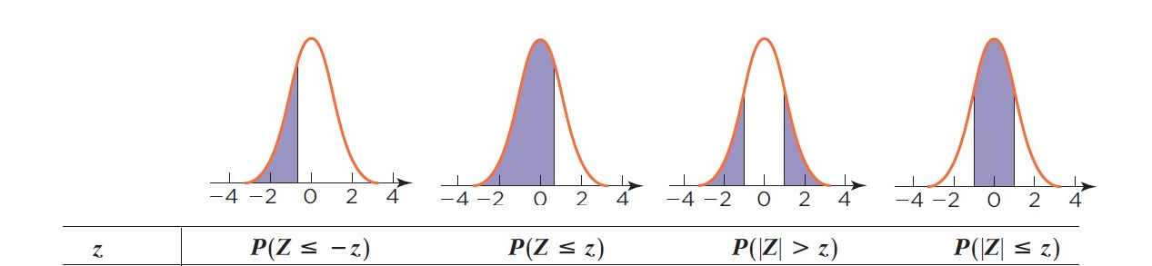
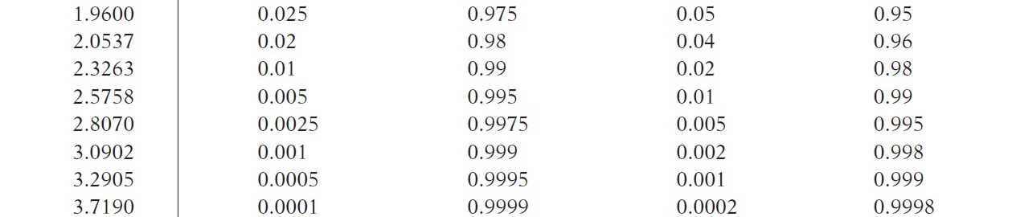
FDA requirement – 1
No more than 1% of the packets/products can be below the weight/amount specified by the label.
1%
1000
µ
The Required Z value = – 2.3263

Slide 24
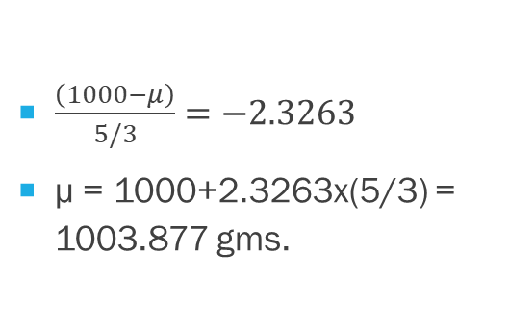
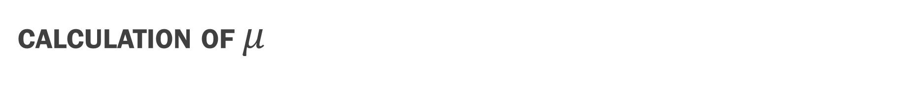
Calculation of $μ$
$\frac{\left(1000−μ\right)}{5/3}=−2.3263$
µ = 1000+2.3263x(5/3) = 1003.877 gms.
<1%
1000
1003.88

Slide 25

FDA requirement – 2
Among the under-weighed packets, the average deficiency can be no higher than 0.5% of the amount specified by the label.
A
A
995
1000
0.00996
Under-weight packets
1000
1003.88
990
995
1000

Slide 26
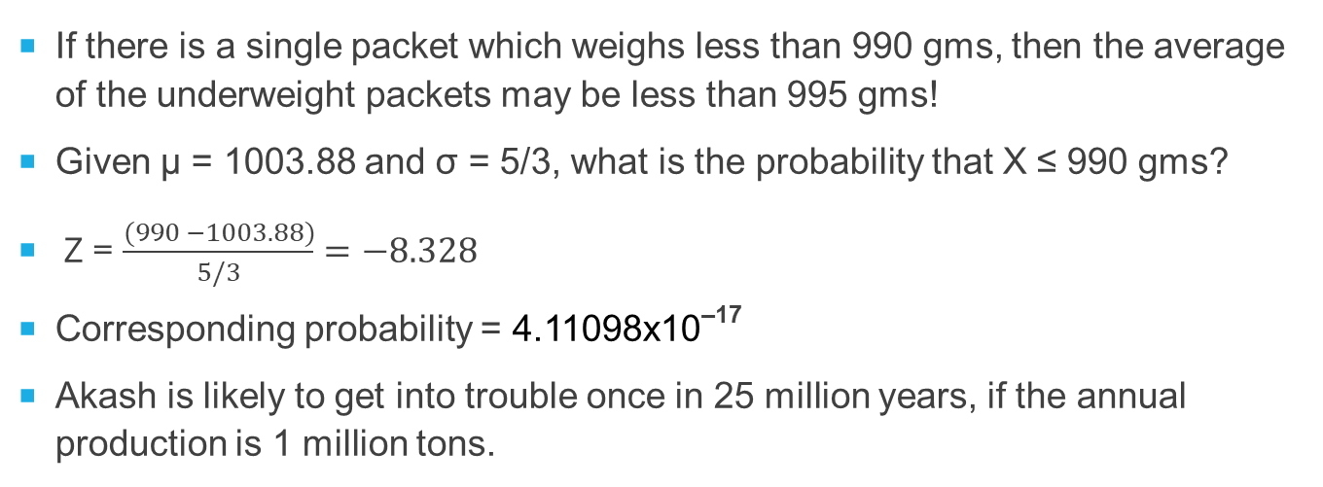
What is the probability that requirement 2 is violated?
If there is a single packet which weighs less than 990 gms, then the average of the underweight packets may be less than 995 gms!
Given µ = 1003.88 and σ = 5/3, what is the probability that X ≤ 990 gms?
Z = $\frac{(990 −1003.88)}{5/3}=−8.328$
Corresponding probability = 4.11098x10^{–17}
Akash is likely to get into trouble once in 25 million years, if the annual production is 1 million tons.

Slide 27
Questions?

